Slide 1

By:-
Mohd. Faizan (00696203617)
Gaurav (41196203617)
Akshit Gupta (41296203617)
Dhruv Parasher (41596203617)
In Guidance of
Dr. Deepak Bhardwaj

Slide 2

What is Data Science?..
Data Science is a blend of various tools, algorithms, and machine learning principles with the goal to discover hidden patterns from the raw data.

Slide 3
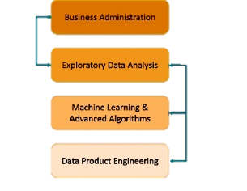
How its Different from Traditional Method?
A Data Analyst explains what is going on by processing history of the data. On the other hand, Data Scientist not only does the exploratory analysis to discover insights from it, but also uses various advanced machine learning algorithms to identify the occurrence of a particular event in the future. A Data Scientist will look at the data from many angles, sometimes angles not known earlier.
Data Science is primarily used to make decisions and predictions making use of predictive causal analytics, prescriptive analytics (predictive plus decision science) and machine learning.
Business Analyst
Data Scientist

Slide 4
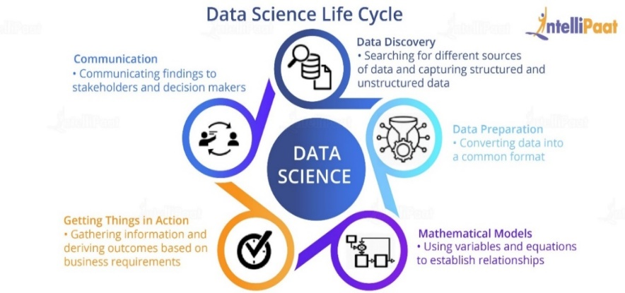
The Project Plan
Data Discovery:- This phase includes ways to discover data from various sources which could be in an unstructured format like videos or images or in a structured format in files or it could be from relational database systems.
Data Preparation:- It includes converting disparate data into a common format in order to work with it seamlessly. This process involves collecting clean data subsets and inserting suitable defaults
Mathematical Models:-All Data Science projects have certain mathematical models to drive them and provides desirable results.

Slide 5

Methodology
Multi Linear Regression:-
Multiple linear regression (MLR), also known as multiple regression, is a statistical technique that uses several explanatory variables to predict the outcome of a response variable.
Its equation is:-
where,
yi​ is the dependent or predicted variable
β0 is the value of y when both xi and x2 are 0.
β1 and β2 are the regression coefficients which is the change in y relative to a one-unit change in xi1 and xi2
βp is the slope coefficient for each independent variable
ϵ is the model’s random error (residual) term.

Slide 6
Steps Involved in any Multiple Linear Regression Model
Importing The Libraries.
Importing the Data Set.
Encoding the Categorical Data.
Avoiding the Dummy Variable Trap.
v. Splitting the Data set into Training Set and Test Set.

Slide 7

CARS SALES PREDICTION

Slide 8
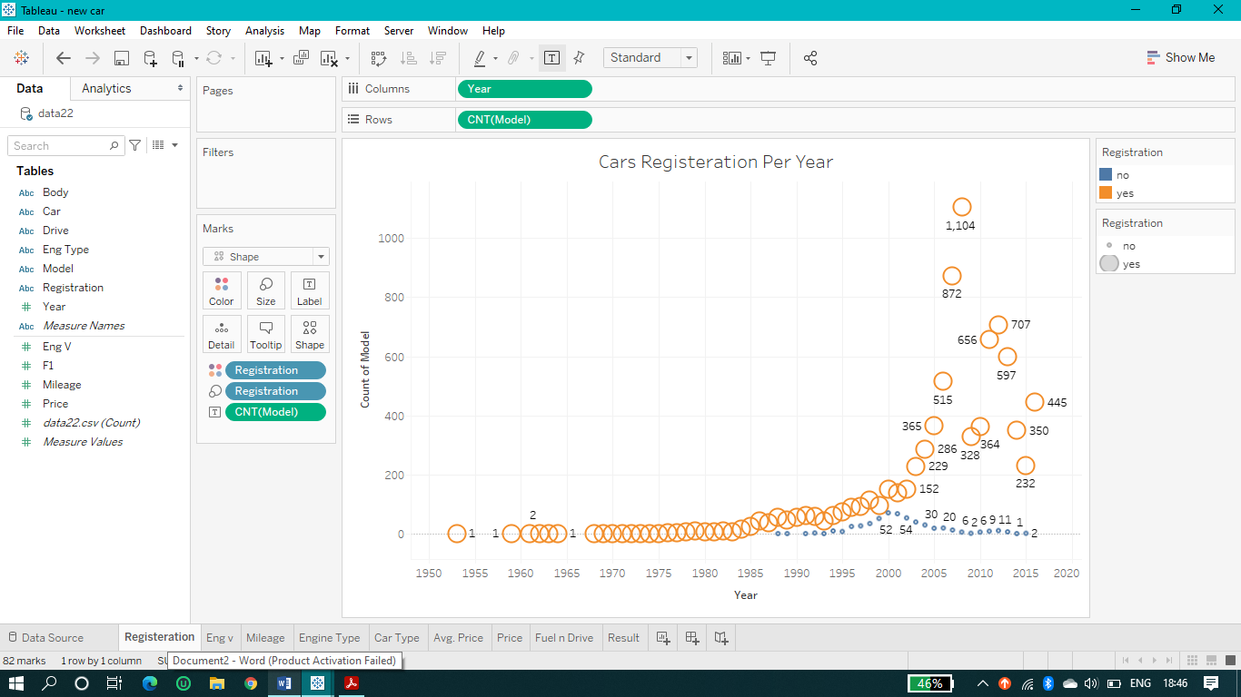
Visualization On Tableau
(Year vs Count of Model )

Slide 9
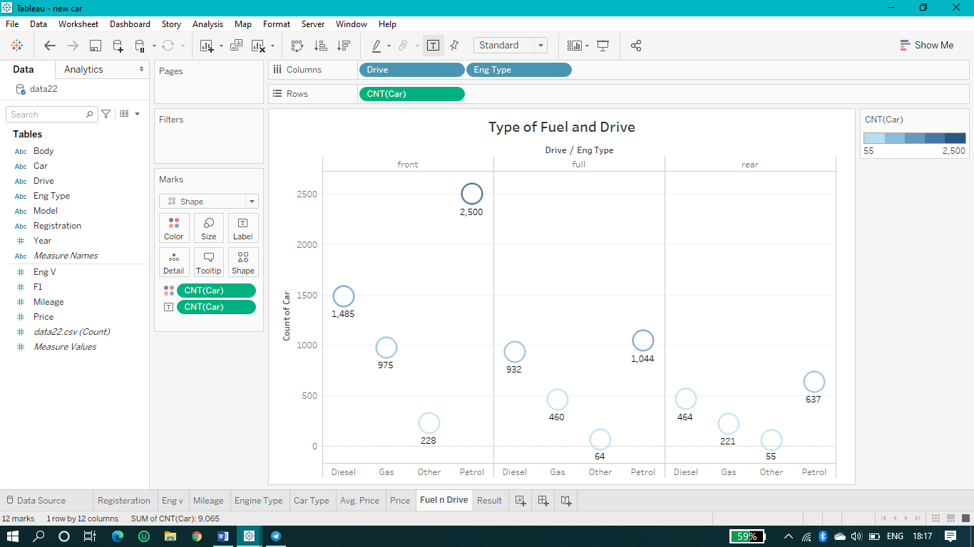
(Type of Fuel vs Count of Car)

Slide 10
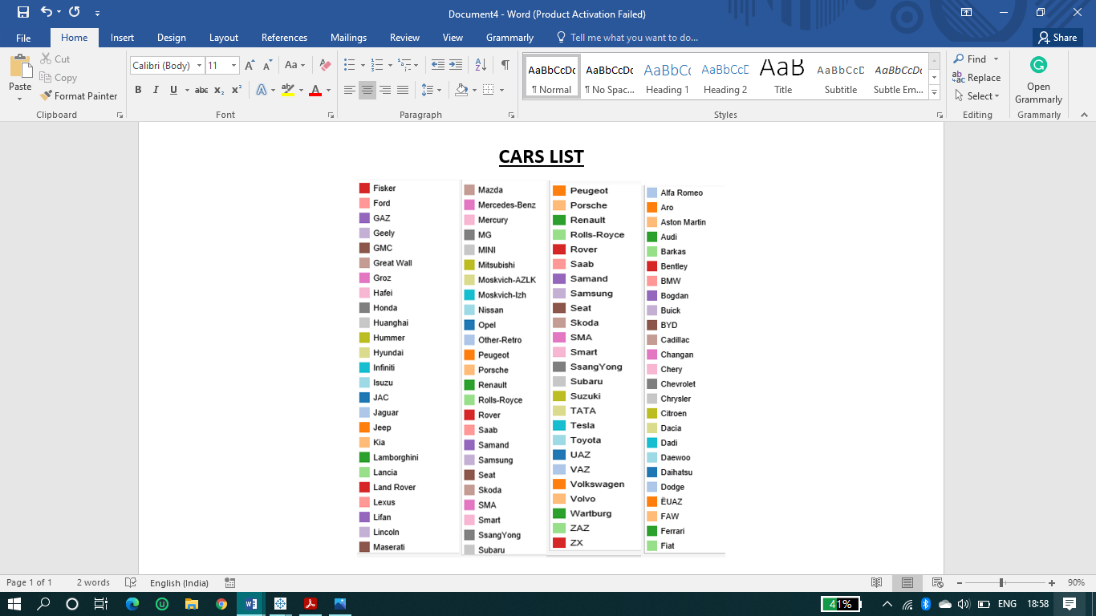

Slide 11
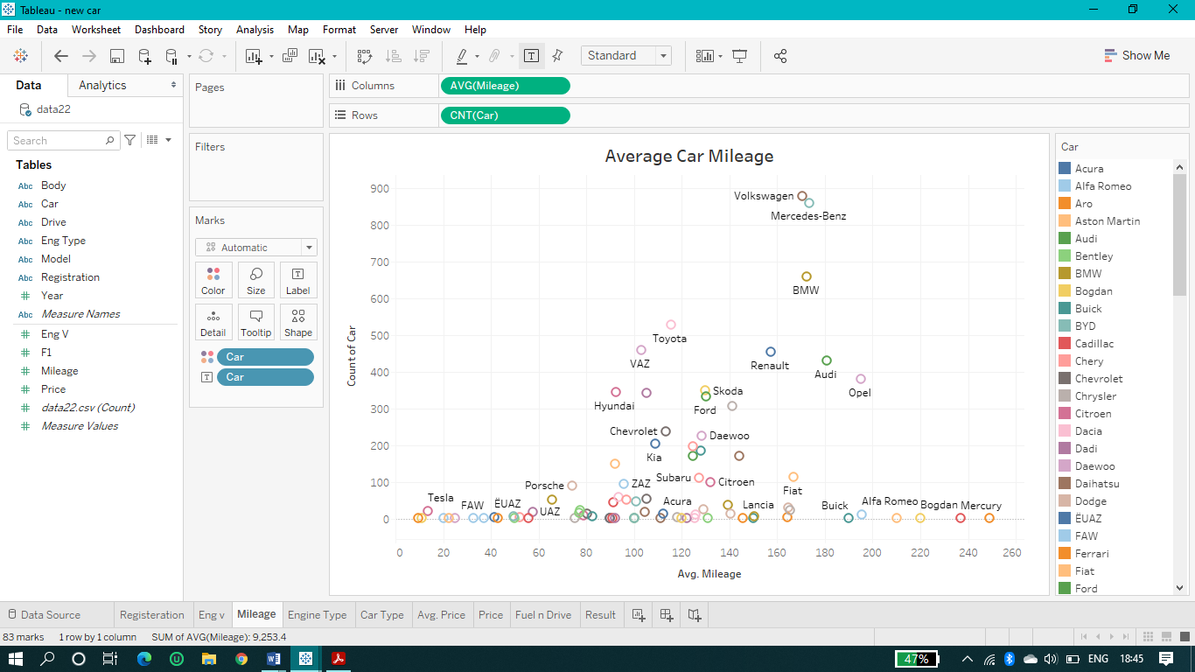
(Average Mileage vs Count of Car )

Slide 12
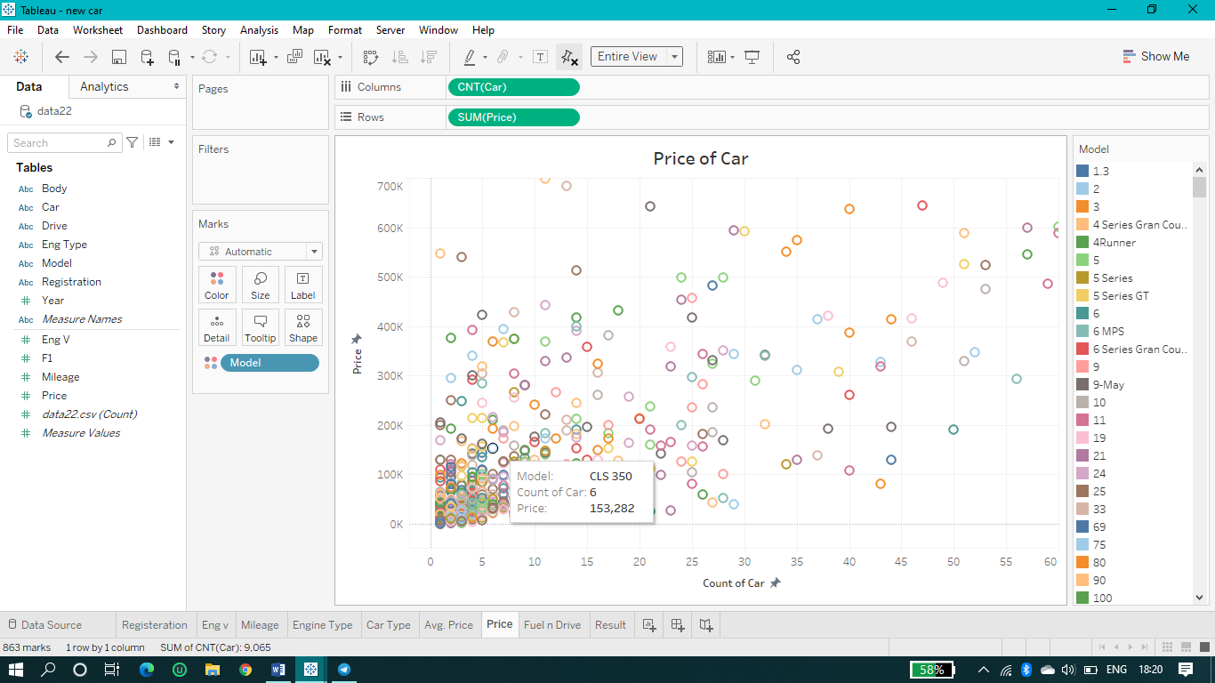
(Count of Car vs Price )

Slide 13

California Housing Prediction

Slide 14
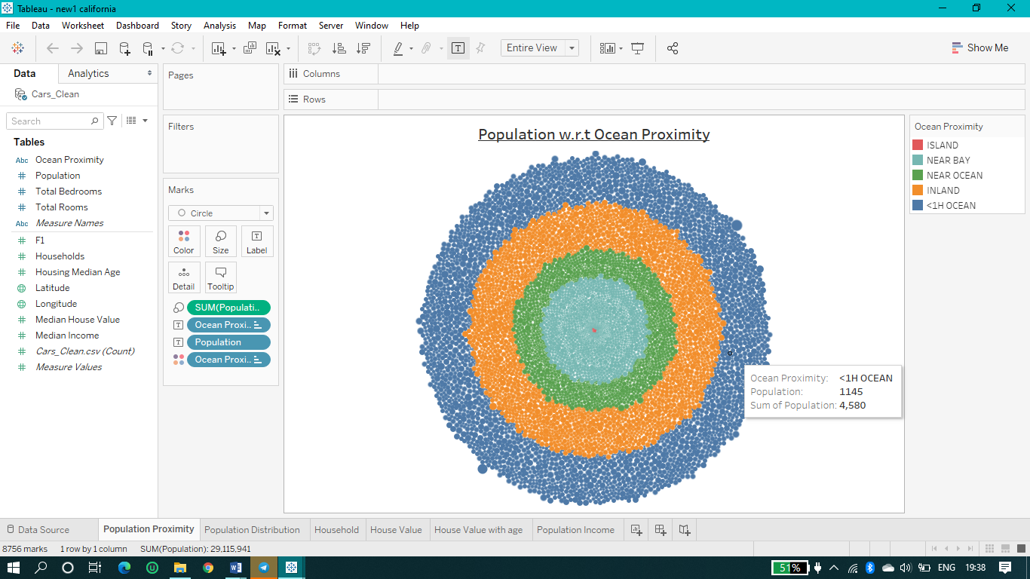
Visualization On Tableau
(Population w.r.t Ocean Proximity)

Slide 15
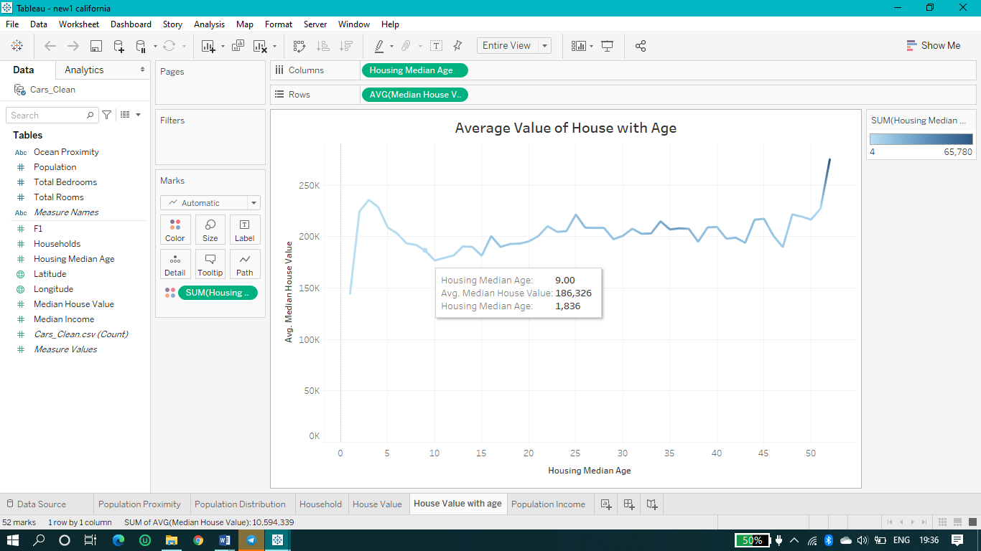
(Housing Median Age vs Average Median House Value )

Slide 16

ADVANTAGES OF DATA PREDICTION MODEL
Smarter detection
Prioritize workloads
Monitor progress
Detect patterns to initiate action
Aggregate and correlate information
Optimize processes and performance

Slide 17
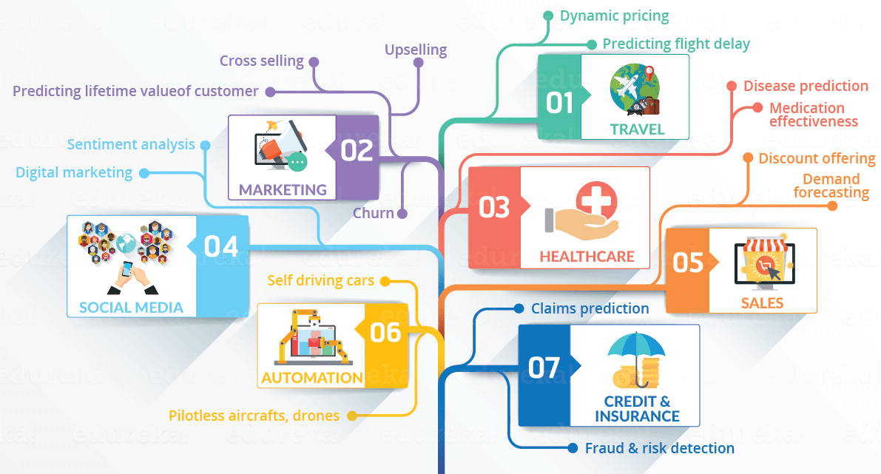
Applications of Data Prediction
Customer Relationship Management
Identifying and predicting disease.
Predicting Automobiles Future Sale.
Optimizing shipping routes in real-time.
Predicting incarceration rates.
And many more..

Slide 18
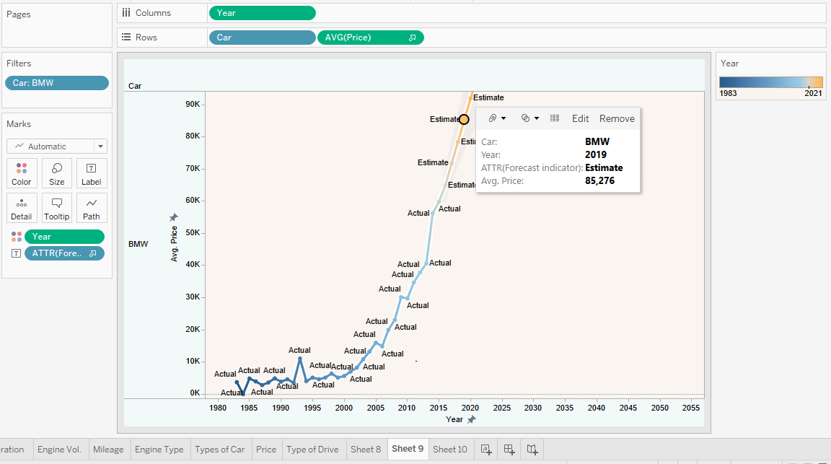
RESULT (Forecasting)
[Year vs Average Price (BMW)]

Slide 19
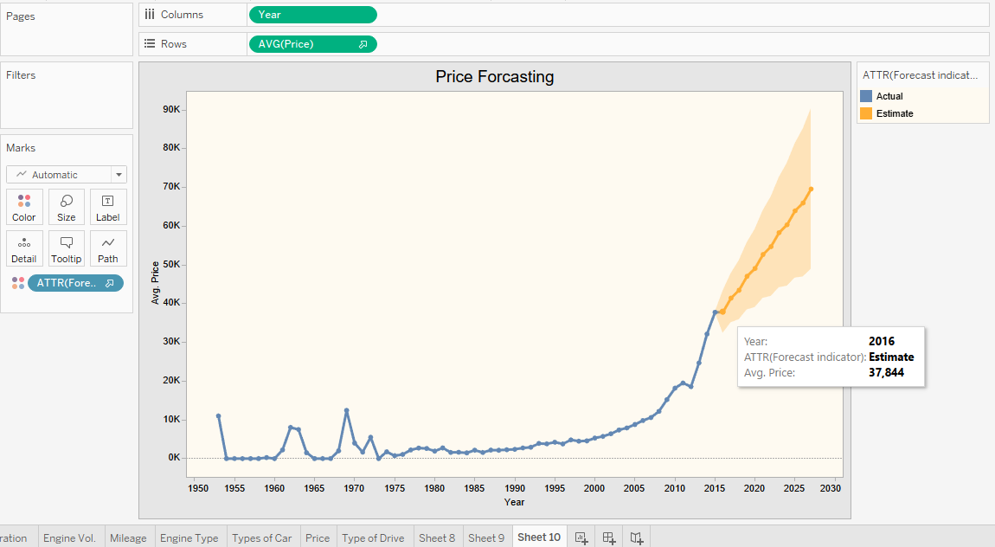
(Year vs Average Price )

Slide 20
CONCLUSION
This paper has presented the Report of our Minor Project, i.e.. DATA PREDICTION MODEL. It has shown all the required information about the introduction, objective, plan, advantages and application of the project. It can make a positive contribution to society. Data science can give you some pretty super superpowers. One of them is reshaping industries like healthcare, business. The amount of data produced about patients and illnesses rises by the second, opening new opportunities for better structured and more informed healthcare. The challenge is to carefully analyze the data in order to be able to recognize problems quickly and accurately – like deepsense.ai did in diagnosing diabetic retinopathy with deep learning.
We made a predictive model using Multi-Linear Regression technique for predicting the sales of automobile company and forecast the estimated value of their respective models w.r.t year.

